Slide 1
Problem Statement
PS-02:Integrated Common Services to common people
By: Saurabh Suman
Faculty of Engineering and Technology, DMIHER Wardha Maharashtra

Slide 2
Unique Idea Brief (Solution)
Comprises of various basic common problem solution with proper security and interface.
Most of the education related constraints are integrated in a single application.
Better user interface and easy to use.
Centralised Experience

Slide 3
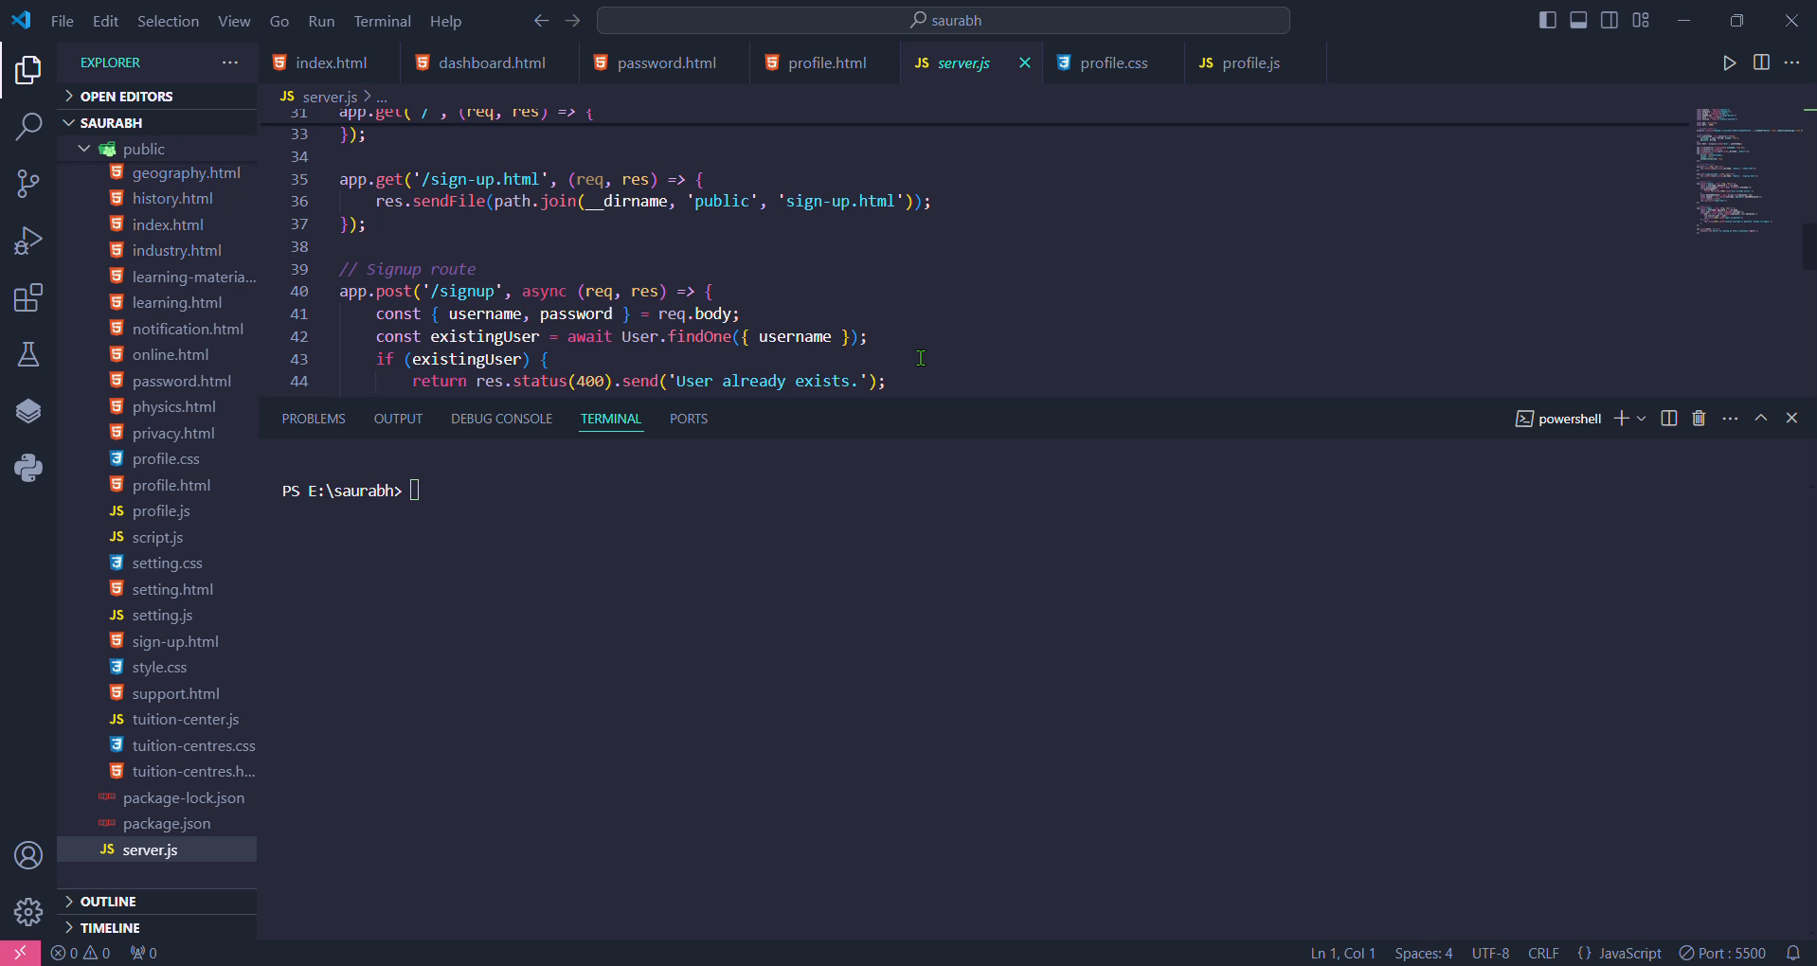
Features Offered
School/College Details
Tuition Centre Details
Learning Resources
Learning Materials
Buy & Sell
Profile edit
Settings
Activity Details
Demo(Video):

Slide 4
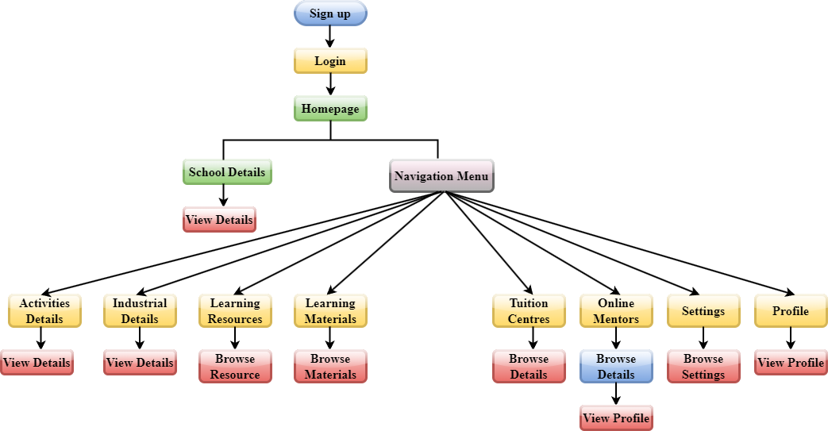
Process flow

Slide 5
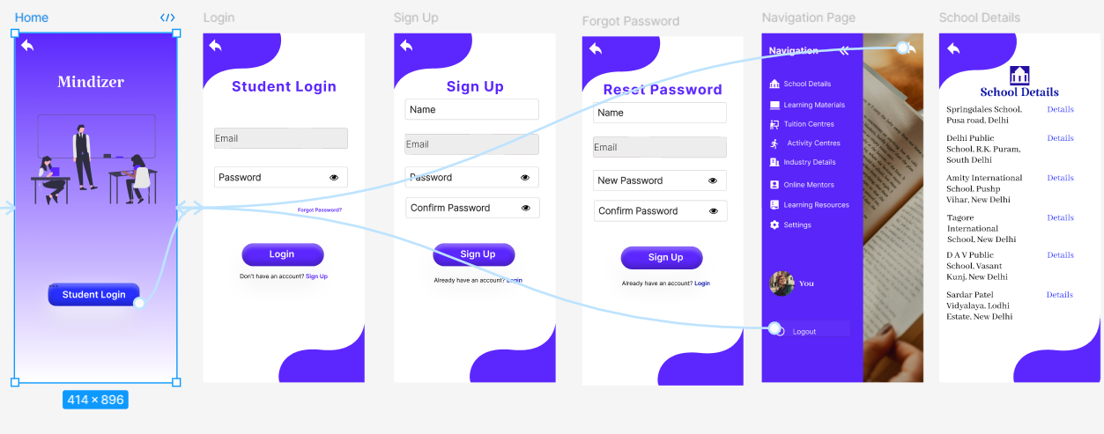
Architecture Diagram

Slide 6
Technologies used
FRONTEND:
HTML
JavaScript
CSS
BACKEND
NodeJs
ExpressJs
MongoDB
Mongoose Compass
APIs & Libraries
Axios
Cors
Body-Parser
Development Tools
Visual Studio Code IDE
Other Technologies
bcrypt.js
dotenv

Slide 7
Conclusion
This platform integrates various educational services and resources into a single, accessible portal.
By offering a diverse range of tools and support, this app significantly improve the learning journey for students.
The intuitive and responsive design ensures seamless navigation and a positive user experience across all devices.
Through easy access to mentorship, training, and educational materials, the app empower students and educators to achieve their goals efficiently.

